Slide 1
Arrays in Java
Rajasekaran S
Assistant Professor,
Department of Information Technology,
KGiSL Institute of Technology,
email: proffraja@gmail.com
Github:www.github.com/rajasekaranap

Slide 2
Arrays
array is a collection of similar type of elements that have contiguous memory location.
array as a collection of variables of the same type.
It provides index based access to the elements.
In java array is fixed in size so it can’t grow more during run time.

Slide 3
Types of Arrays in Java
Arrays
Single Dimensional
Multi Dimensional

Slide 4
How to Declare an Array
Syntax
Method 1:
datatype[] variable_name = new datatype[size];
int[] a = new int[5];
Method 2:
datatype[] variable_name = {element 1, element 2 …}
int[] a = {1,2,3,4,5};
This is for Single Dimension Array

Slide 5
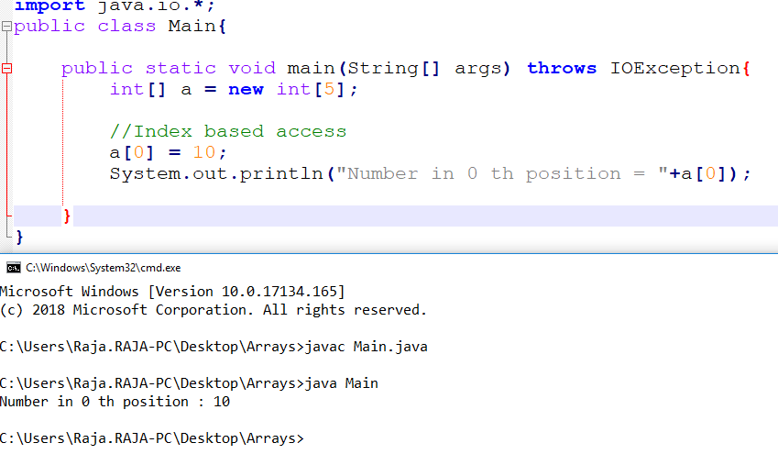
Creation of Array Method 1

Slide 6
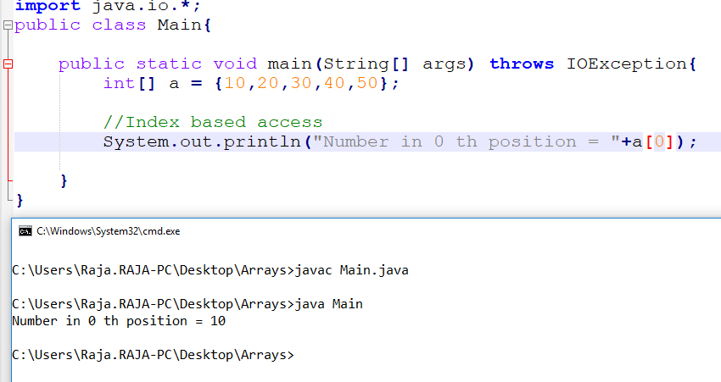
Creation of Array Method 2

Slide 7
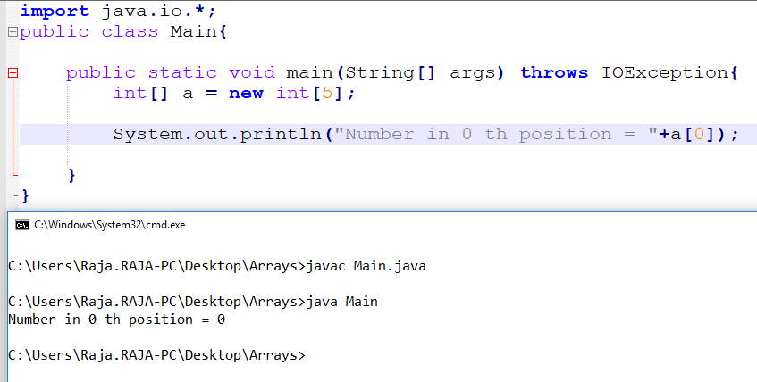
Uninitialized Array
Default value is assigned

Slide 8
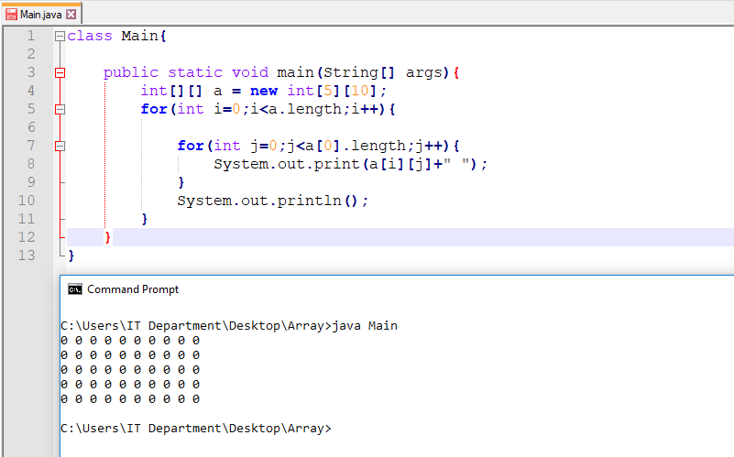
Multidimensional Array

Slide 9
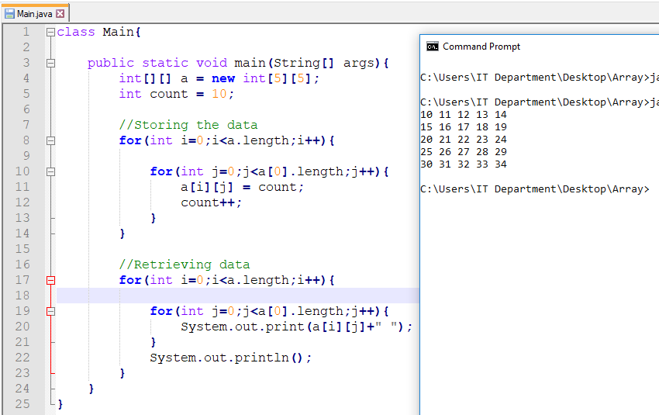
Using Multidimensional Array

Slide 10
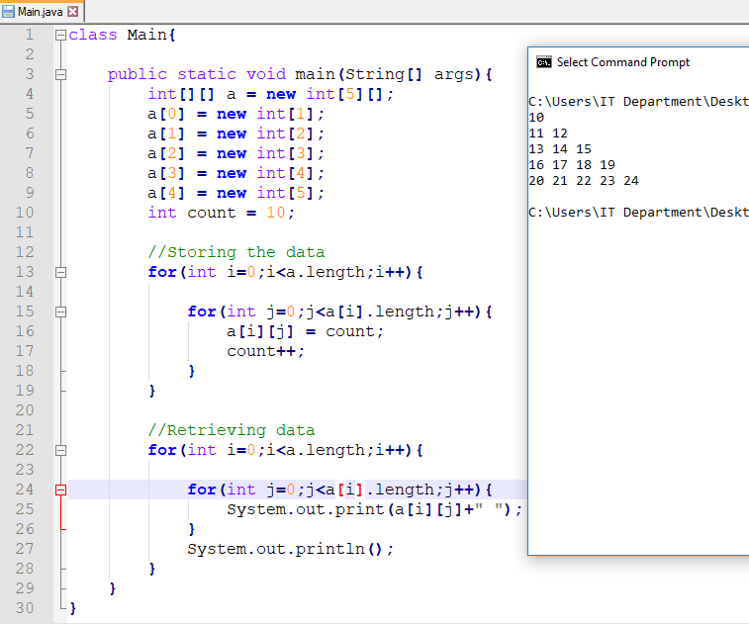
Jagged Array

Slide 12
Thank You
Rajasekaran S
Assistant Professor,
Department of Information Technology,
KGiSL Institute of Technology,
email: proffraja@gmail.com
Github:www.github.com/rajasekaranap

